Slide 1


Department of ECE
College of Engineering Guindy, Anna University, Chennai
EC5030 – Project Review 1
Presentation for the First Review
14th October, 2025.
DESIGN AND VERIFICATION OF UART COMMUNICATION PROTOCOL USING SYSTEM VERILOG
Presented by:
Umesh Kanna. K. B (2022105010)
Rubesh
Jaganath
B.E - ECE (IVth year)
Under the Guidance of:
Dr. S. R. SRIRAM
Associate Professor
Department of ECE
CEG Campus, Anna University

Slide 2

Table of Contents
Introduction
Literature Review
Inference from Literature review
Problem statement
Project objective
Existing Techniques
Block Diagram
Work done
Timeline
Conclusion
References

Slide 3
Introduction - Sleep Apnea
SLEEP APNEA
Sleep apnea (SA) is a prevalent sleep related respiratory and neurological disorder, characterized by
frequent interruptions in breathing during sleep, leading to decreased levels of blood oxygen.
Recurrent breathing interruptions lasting around 10-20 seconds during sleep.
Fgi1: Sleep Apnea, source- www.mayoclinic.org

Slide 4
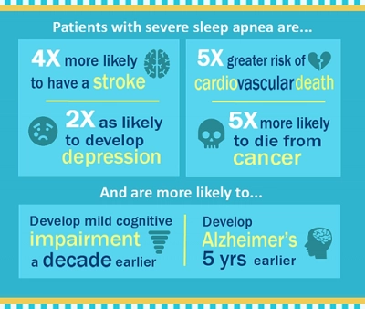
Introduction
The American Association of Sleep Medicine (AASM) ranks sleep apnea among the top 10% of high-risk disorders leading to death.
A recent 18-year study at the University of Wisconsin-Madison individuals with SA are:
3 times more vulnerable to diseases and mortality.
Undiagnosed and untreated in approximately 90% of affected individuals.
Fig2:Wisconsin-Madison Statistics source- a-fib.com

Slide 5
Features and Symptoms
EARLY SYMPTOMS
DAYTIME FATIGUE
LOUD SNORING AND MORNING HEADACHES
MOOD SWINGS OR IRRITABILITY
POOR CONCENTRATION
INTERMITTENT HYPOXIA AND BREATHING PAUSES DURING SLEEP
SEVERE/ LONG TERM COMPLICATIONS
HYPERTENSION
ARRHYTHMIAS AND STROKE
CARDIOVASCULAR DISEASES
COGNITIVE DECLINE (DEMENTIA)
TYPE-2 DIABETES
Characterized by:
Temporary, repetitive closure of upper airway (pharynx) during sleep
Airflow partially or completely blocked
Leads to:
Decreased blood oxygen (O₂) level
Increased carbon dioxide (CO₂) level
Brain detects imbalance → triggers respiratory effort
Causes arousal from sleep to resume breathing.
Table1: Symptoms and complications

Slide 6
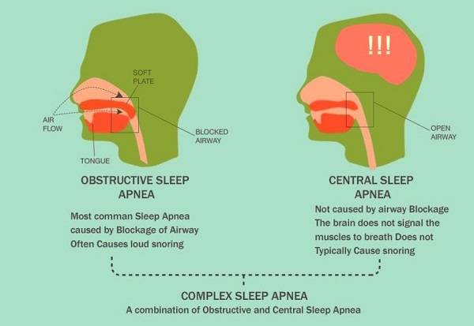
Types of Sleep Apnea
Sleep apnea is classified into:
Obstructive Sleep Apnea (OSA)
Caused by upper airway obstruction due to muscle relaxation during sleep.
Central sleep apnea
Results from neurological dysfunction where the brain fails to send proper signals to breathing muscles.
Mixed Sleep Apnea (MSA) combines features of both.
Fig3: https://www.patientsengage.com

Slide 7
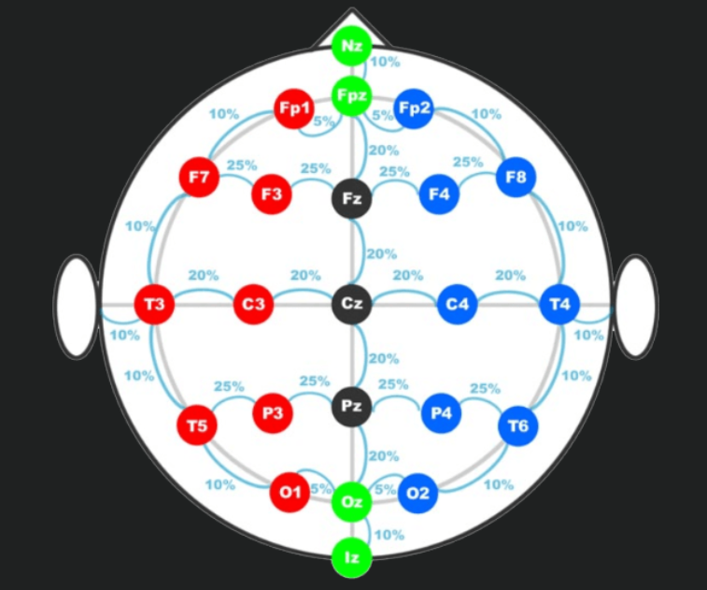
EEG (Electroencephalogram)
EEG literally means a recording of the electrical activity of the brain.
Small electrodes are attached to pick up the electrical signals produced by the brain.
The 10–20 system is a standardized method to place EEG electrodes on the scalp.
It ensures reproducibility and comparability across studies and patients.
In EEG recordings, electrodes are attached to the scalp using a special conductive gel or paste.

Slide 8
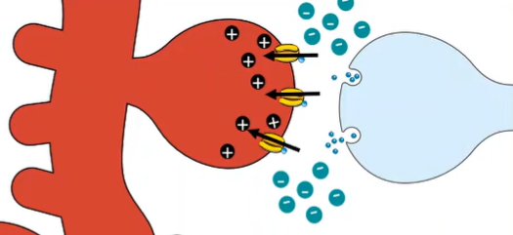
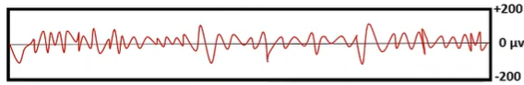
EEG (Electroencephalogram)
Neurons communicate via electrical and chemical signals.
Synapse - junction between two neurons.
Presynaptic neuron: sends the signal.
Postsynaptic neuron: receives the signal.
When an action potential reaches the presynaptic terminal, calcium ions flow in, triggering vesicles to release neurotransmitters into the synaptic cleft, where they bind to the postsynaptic neuron and pass the signal forward.

Slide 9
EEG (Electroencephalogram)
Sub-Band | Frequency (Hz) | Associated State
Delta (δ) | 0.5–4 | Deep sleep
Theta (θ) | 4–8 | Light sleep, drowsiness
Alpha (α) | 8–13 | Relaxed wakefulness
Beta (β) | 13–30 | Active thinking, alertness
Gamma (γ) | 30–100 | Cognitive processing, attention

Slide 10
EEG (Electroencephalogram)
WHY EEG?
Detects Sleep Stages:EEG can classify NREM and REM sleep.Sleep apnea often disrupts normal sleep patterns, which EEG can capture.
Detects Arousals:When breathing stops, the brain briefly wakes up to restore airflow.These micro-arousals are seen as spikes or sudden shifts in EEG patterns.
Shows Brain Response to Oxygen Deprivation:EEG can reflect changes in neural activity due to hypoxia (low oxygen levels caused by apnea events).
Non-invasive Monitoring:EEG allows overnight recording in a sleep lab or at home.This is practical for diagnosing and monitoring sleep apnea without invasive tests.

Slide 11
Literature Review
SNO | TITLE | METHODOLOGY | NOVELTY/ ADVANTAGES | LIMITATIONS/ DISADVANTAGES | PARAMETERS
1. | Hadj Salah, S. B., Chouchene, M., & Sayadi, F. E. (2024). FPGA implementation of a Convolutional Neural Network for Alzheimer's disease classification. In 2024 21st International Multi-Conference on Systems, Signals & Devices (SSD) (pp. 193-198). IEEE. | CNN model trained on PET scans, converted into IP using Vivado HLS, deployed on PYNQ-Z2 FPGA using a co-design approach (PS + PL) | - High accuracy (>99%) - Low power (1.52W) - Real-time classification - Suitable for edge AI in healthcare | - Only uses PET scan - Requires design expertise in HLS + FPGA - Focused on offline validation | - Accuracy: 99.60% (Model 1) - Power: 1.521W - Resource usage: 41.18% LUTs - Time: 5–17 min
2. | Sağlam, S., Tat, F., & Bayar, S. (2019). Fpga implementation of cnn algorithm for detecting malaria diseased blood cells. In 2019 International Symposium on Advanced Electrical and Communication Technologies (ISAECT) (pp. 1-5). IEEE. | Dataset of 8×8 binary images (200 samples total); CNN designed in MATLAB and converted to VHDL; Layers include convolution, padding, pooling, flatten, and fully connected; Implemented on Zynq-7000 FPGA | Fast execution (5.93 ns); Very low LUT usage (4.34%); Demonstrates real-time image classification using CNN on FPGA | Very small, synthetic binary image dataset; Not representative of real-world malaria images; Only binary classification; No grayscale or feature-rich input | FPGA: Zynq-7000; Tool: Vivado; Model: CNN; Input: 8×8 binary images; Accuracy: 94.76%; Time: 5.93 ns; Language: VHDL
3. | Selvathi, D., & Nayagam, R. D. (2016). FPGA implementation of on-chip ANN for breast cancer diagnosis. Intelligent Decision Technologies, 10(4), 341-352. | Uses Wisconsin Breast Cancer Dataset (WBCD); ANN with 30 inputs, 10 hidden neurons, 1 output; Fully implemented in VHDL; Synthesized using Xilinx ISE and implemented on Spartan-3E | Fully on-chip, standalone diagnosis without need for external processing; Low power and area-efficient; Suitable for embedded health systems | Not suitable for image classification; Lower flexibility; ANN offers lower accuracy compared to deep learning models; No real-time data capture | FPGA: Spartan-3E; Tool: Xilinx ISE; Model: ANN; Input: Tabular data (30 features); Accuracy: 93.9%; Language: VHDL

Slide 12
Literature Review
SNO | TITLE | METHODOLOGY | NOVELTY/ ADVANTAGES | LIMITATIONS/ DISADVANTAGES | PARAMETERS
4. | Khan, M., Moiz, A., Khan, G. N., Wajid, M., Usman, M., & Ali, J. (2025). An FPGA Prototype for Parkinson’s Disease Detection using Machine Learning on Voice Signal. IEEE Access. | Parkinson’s disease detection using voice-based features using three feature selection algorithms and assessed using five classifiers. Implemented in Nexys A7 FPGA | - First time FPGA implementation for PD voice detection - performance acceleration, energy efficiency and better accuracy | - Influence of non-PD related voice variation impacts accuracy due to performance reliance on dataset’s diversity - lack of adaptive models due to dynamic nature of PD | - Feature Selection Algorithms: Chi-squared, Minimum Redundancy Maximum Relevance (mRMR), Analysis of Variance (ANOVA) - Classifiers: K-Nearest Neighbors (KNN), Decision Tree (DT), Artificial Neural Network (ANN), Logistic Regression (LR), and Support Vector Machine (SVM). - Dataset imbalance: Synthetic Minority Over-sampling Technique (SMOTE) - dynamic power: 23mW - ANOVA with Quad SVM accuracy: 98.86%
5. | Alam, M. S., Siddiqui, Y., Hasan, M., Farooq, O., & Himeur, Y. (2024). Energy-efficient FPGA based sleep apnea detection using EEG signals. IEEE Access, 12, 40182-40195. | Multiband EEG signals are analysed to detect sleep apnea using a Linear support vector machine (LSVM) classifier, built on Artix7 FPGA. uses St. Vincent’s sleep apnea UCDDB database. | - Improved speed, accuracy (94%), sensitivity, and energy efficiency. - System on Chip (SoC) predictive model | Polysomnography for EEG recording causes discomfort and decreases the convenience for real-time testing and efficiency | - highest accuracy: 94.81% - sensitivity: 93.10% - specificity: 96.43% - dynamic power:19mW

Slide 13
Literature Review
SNO | TITLE | METHODOLOGY | NOVELTY/ ADVANTAGES | LIMITATIONS/ DISADVANTAGES | PARAMETERS
6.. | Hassan, O., Paul, T., Amin, N., Titirsha, T., Thakker, R., Parvin, D., ... & Islam, S. K. (2023). An optimized hardware inference of SABiNN: Shift-accumulate binarized neural network for sleep apnea detection. IEEE Transactions on Instrumentation and Measurement, 72, 1-11. | - Designed and implemented a Shift-Accumulate Binarized Neural Network (SABiNN) on FPGA- Optimized binarized operations with shift-accumulate logic to eliminate multipliers- Used sleep apnea ECG data with preprocessing: normalization, R-peak segmentation- HDL synthesized and deployed on Artix-7 FPGA for real-time inference | - Removes multipliers using bitwise logic, significantly reducing power and area- 3.5× speedup vs. conventional BNNs- Up to 11.2× better energy efficiency compared to CPU-based inference- Ideal for energy-constrained wearable medical systems | - Only single-channel ECG considered; lacks multi-modal sensor fusion- Architecture tailored for SABiNN—less generalizable- Detection performance not compared against state-of-the-art ML/DL methods | - Model: SABiNN (3-layer binarized NN)- Accuracy: ~87.14%- Platform: Xilinx Artix-7 FPGA- Optimizations: Bitwise operations, shift-accumulate- Speedup: 3.5× vs BNN- Energy Efficiency: 11.2× vs CPU- Dataset: Sleep apnea ECG from PhysioNet
7. | Karthick, S., & Devarasu, N. (2025). VLSI Architecture for Modulating Nerve Activity in Parkinson’s disease Using STFT Transformation Methods. In 2025 Eleventh International Conference on Bio Signals, Images, and Instrumentation (ICBSII) (pp. 1-7). IEEE. | STFT (short-time fourier transform) transformation + CNN is used to modulate neural activity using EEG in Parkinson’s disease for detection and is implemented in Virtex 6 FPGA. Pre-processing using bandpass filters | - improved performance when compared to traditional methods. - As the number of samples increases, the latency per sample decreases. - The power usage of the system increases linearly with the number of samples processed. | - Computational complexity and power consumption of the VLSI architecture are the limitations. - EEG variation due to differences in brain activity, disease progression, and medications is a challenge. - External noise and movement artefacts distort signal quality, affecting detection accuracy. | - Power consumption: 0.12 mW at 100 samples to 1.80 mW at 2000 samples. - STFT + CNN accuracy: 95.2%

Slide 14
Literature Review
SNO | TITLE | METHODOLOGY | NOVELTY/ ADVANTAGES | LIMITATIONS/ DISADVANTAGES | PARAMETERS
8. | Kocaoğlu, S. (2025). FPGA implementation of deep learning architecture for ankylosing spondylitis detection from MRI. Scientific Reports, 15(1), 21854. | To Diagnose AS that classifies MRI sequences using Deep learning neural networks (ResNet-50) and implemented in the Xilinx KV260 FPGA board. | - First ever study to diagnose AS on FPGA. - Higher accuracy achieved when compared to similar implementations on FPGA for MRI-based classification or segmentation tasks - low latency execution through parallel processing | - Only a single CNN (ResNet) was used for feature extraction. - Small-sized dataset | - accuracy: 90.8% - high sensitivity: 100% - F-score: 91.60% - True Positive Rate (TPR) of 100% and a False Positive Rate (FPR) of 18.5%. - Area under the ROC Curve (AUC)- 0.91
9. | Chen, C., da Silva, B., Yang, C., Ma, C., Li, J., & Liu, C. (2023). AutoMLP: A framework for the acceleration of multi-layer perceptron models on FPGAs for real-time atrial fibrillation disease detection. IEEE Transactions on Biomedical Circuits and Systems, 17(6), 1371-1386. | A framework (AutoMLP) automates the acceleration of the Multi-Layer Perceptron(MLP) model on the Xilinx PYNQ-Z1 (Zynq 7020) for Atrial Fibrillation Detection. | - Model Topology- Compiler to Underlying Design - Adjusted Bit-widths- Simulation & Profiling - Parallel Optimization- Design-Space Exploration | - Complex FPGA design process - High resource usage for complex MLP topologies - Accuracy trade-off with reduced bit-width - Overhead from fixed-point format conversion | 1.MLP_Saric: - Single hidden layer MLP with 46 hidden nodes - Accuracy 98.94% , power 0.011w 2. MLP_Borghi - multi layer MLP with 180 hidden nodes - Accuracy 97.39%, power 0.017w 3.MLP_3Layers 1 hidden layer - accuracy 98%(CPSC)/ 93.29%(AFDB), power 0.01w 4. MLP_5Layers with 12,16,12 nodes in the hidden layer. - accuracy 98.23%(CPSC)/ 94.2%(AFDB) - power 0.012 w

Slide 15
Literature Review
SNO | TITLE | METHODOLOGY | NOVELTY/ ADVANTAGES | LIMITATIONS/ DISADVANTAGES | PARAMETERS
10. | Pan, S. Y., Nguyen, D. H., & Chao, P. C. P. (2025). Hardware-accelerated neural network model for early prediction of sudden cardiac arrest based on heart rate variability metrics. Microsystem Technologies, 31(5), 1231-1245. | - ECG signals from MIT-BIH NSR and SCD databases - Extracted 9 HRV features (time, frequency, nonlinear) - Neural Network with 3 hidden layers (16–32–64 neurons) - Leave-one-subject-out cross-validation - Implemented on Artix-7 FPGA using Verilog HDL | - Predicts SCA up to 55–60 mins early (one of the earliest windows) - Hardware acceleration yields ~500× faster inference - Uses 18-bit fixed point for optimized accuracy vs. cost - Suitable for real-time wearable device deployment | - Relies only on HRV; other ECG features ignored - Limited to MIT-BIH dataset; generalization to other datasets not evaluated - Prediction model may struggle with more complex cardiac cases | - Accuracy: 96.23% - Sensitivity: 94.35% - Specificity: 98.12% - Latency: 3.62 µs - Clock: 50 MHz - LUTs: 3547 (2.65%) - Registers: 1810 (0.67%) - DSPs: 16 (2.16%)
11. | Hassan, O., Paul, T., Thakker, R., Parvin, D., Shuvo, M. M. H., Mosa, A. S. M., & Islam, S. K. (2022). A multi-sensor based automatic sleep apnea detection system for adults using neural network inference on FPGA. In 2022 IEEE International Symposium on Medical Measurements and Applications (MeMeA) (pp. 1-6). IEEE. | - Developed a neural network (Feedforward Neural Network) for binary classification of apnea events- Combined data from ECG and SpO₂ sensors (Apnea-ECG dataset)- Applied pruning (15%) to reduce model size- Implemented hardware-software co-simulation- Deployed quantized network on Artix-7 FPGA board | - Low-power (52W) hardware implementation- 5× less power than commercial ML accelerators- Compact, real-time wearable solution- Works with minimal sensors: ECG patch and pulse oximeter | - Accuracy (87.41%) slightly lower than more complex methods- No integration of airflow or respiratory effort data- Results depend on calibration and signal quality | - Accuracy: 87.41%- Sensitivity: 93%- Dataset: Apnea-ECG (PhysioNet)- Platform: Artix-7 Nexys FPGA board- Optimizer: Adam- Activation functions: ReLU (hidden), Sigmoid (output)- Quantization & pruning: 15% neuron/weight reduction- Power ~consumption: ~52W

Slide 16
Inference from Literature survey
These works span a wide range of diseases: neurodegenerative (Alzheimer’s, Parkinson’s, Sleep Apnea), cardiovascular (Atrial Fibrillation, Cardiac Arrest), infectious diseases (Malaria), and musculoskeletal disorders (Ankylosing Spondylitis, Breast Cancer).
Various ML models, including Convolutional Neural Networks (CNN), Support Vector Machines (SVM), K-Nearest Neighbors (KNN), Artificial Neural Networks (ANN), and Long Short-Term Memory (LSTM), have been used for preprocessing medical data and are widely used for image and signal-based disease classification (e.g., Alzheimer’s, Malaria, Parkinson’s).
FPGA platforms like Artix-7, Zynq-7000, PYNQ-Z2, KV260 enable hardware acceleration and edge deployment with lesser dynamic power.

Slide 17
Inferences from Literature survey
Quantization, pruning, and bit-width reduction together shrink model size, cut memory and computation needs, and boost FPGA inference speed by up to 4× while reducing power consumption by 30–50% with minimal accuracy loss.
Optimized neural networks (e.g., SABiNN – Shift-Accumulate Binarized Neural Network) highlight the trend of tailoring architectures for FPGA efficiency.
Signal transforms (STFT, Hilbert, FFT, filtering) are widely combined with AI models for better disease detection from biosignals.
Using hybrid CNN architectures for biosignal analysis improves feature extraction efficiency, yielding accuracy improvements of 2–5% over standalone CNN or LSTM models.

Slide 18
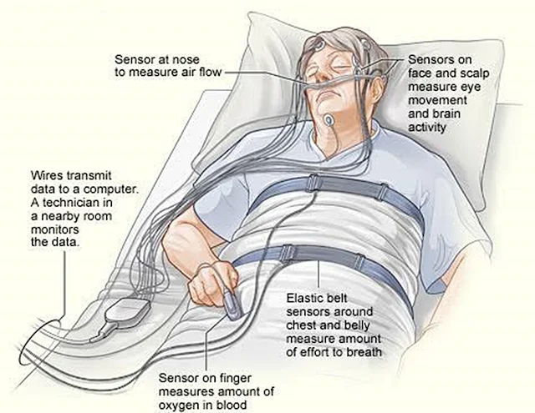
Problem Statement
Sleep Apnea can lead to severe health
consequences such as:
Cardiovascular complications.
Cognitive impairment and fatigue.
Current Diagnostic Method:
Polysomnography (PSG)
Standard clinical method for detecting
sleep disorders.
Requires immobile, sensor-heavy setups.
Technician-dependent analysis
Challenges with Current Machine Learning Models
Computationally intensive.
High memory requirements.
Difficulty in portable or resource-constrained devices.
fig: Sleep Test - Polysomnography - PSG / Image source: World Chronicle Polysomnography Market Research Report Analysis

Slide 19
Project Objectives
Design and implement
A low-latency, energy-efficient Sleep Apnea detection system using biosignals (EEG).
Develop a CNN model
Integrated with compatible classifiers, suitable optimization algorithms, and efficient activation functions for accurate classification of apneic and non-apneic events.
Optimize and deploy the model
Implementing techniques to reduce computational and memory overhead, and deploy model on FPGA.
Evaluate system performance
classification accuracy, performance metrics, latency,
power consumption, and FPGA area utilization.

Slide 20
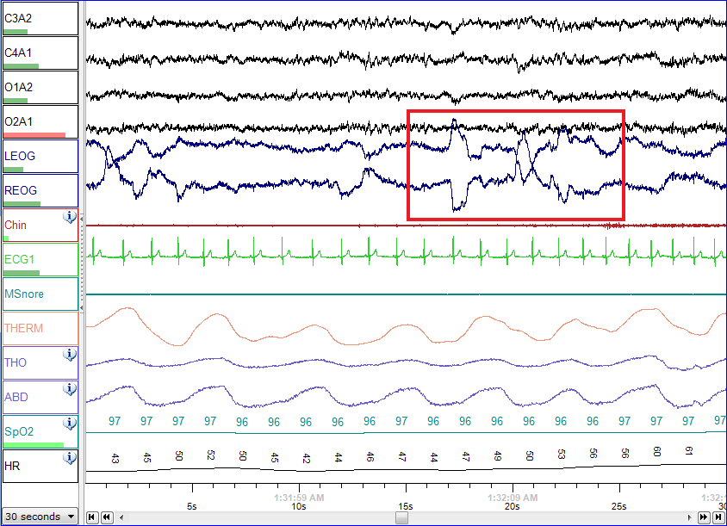
Existing Techniques
1. Polysomnography (PSG):
It is the gold standard clinical
method for diagnosing sleep apnea.
Uses multiple sensors to measure
EEG, ECG, airflow, oxygen levels,
and muscle activity during sleep.
Limitations include high cost,
immobility, need for technician supervision,
and discomfort in clinical settings.
PSG is ideal for diagnosis but unsuitable
for continuous real-time monitoring
Fig. PSG of a person in REM sleep.

Slide 21
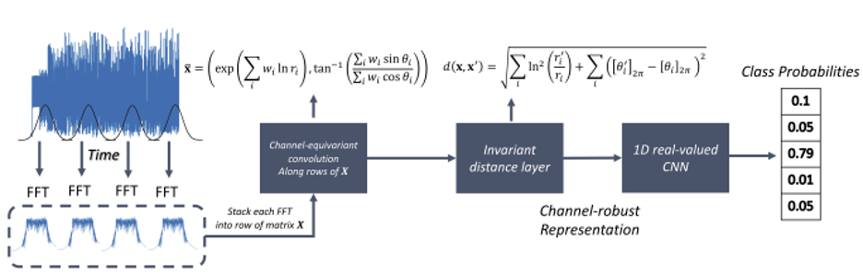
Existing Techniques
2. Machine Learning on Extracted features:
Uses algorithms like SVM, KNN, Decision Trees on HRV, EEG bands, entropy.
Requires handcrafted features and intensive preprocessing.
Limitations: Not suitable for real-time edge deployment.

Slide 22
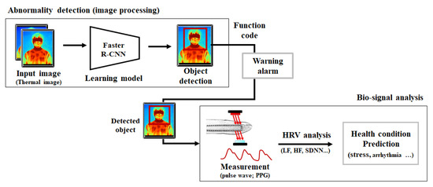
Existing Techniques
3. Deep Learning on Bio signals:
Works well with large datasets in Python frameworks (TensorFlow/PyTorch).
Requires high-end GPU, consumes significant power → Not feasible for wearables.

Slide 23
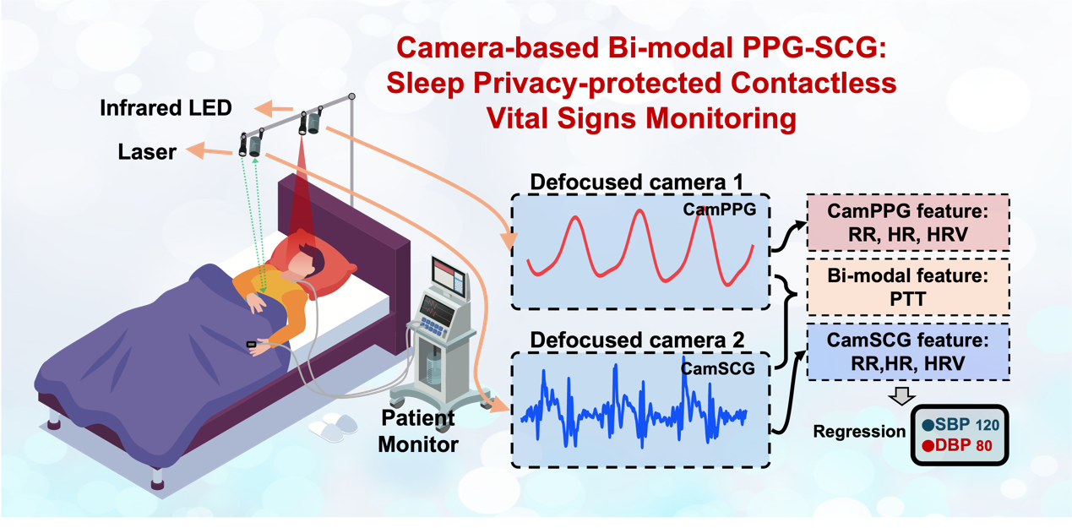
Existing Techniques
4.Contactless Camera-Based Sleep Monitoring
Uses thermal or infrared cameras to track chest movement and breathing.
AI models estimate apnea events via motion analysis.
Expensive setup, privacy issues, limited to still environments.

Slide 24
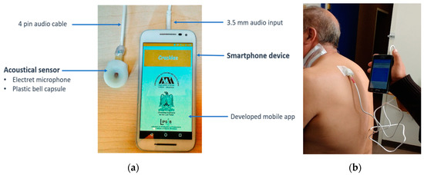
Existing Techniques
5.Smartphone/IoT-based Detection using Audio/Radar:
Detects apnea via snoring patterns, breathing sounds, or radar-based movement.
Uses mobile sensors or mmWave radar to capture breathing anomalies.
Less accurate due to ambient noise, body position variation

Slide 25
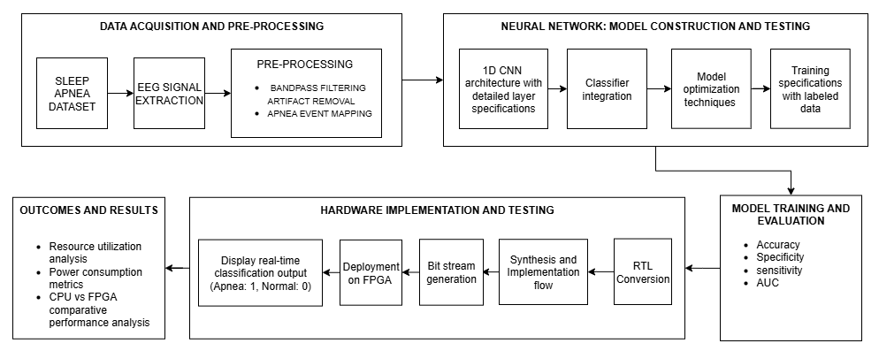
Block Diagram

Slide 26
Work done for Review-1
01
DATA ACQUISITION
Polysomnography dataset
Public/Private Dataset
02
EEG EXTRACTION AND MAPPING
C3A2 and C4A1 extraction
Mapping the APNEA event based on time sequence
03
ARTIFACTS REMOVAL AND SIGNAL PRE-PROCESSING
Filtering out noise using bandpass filter to extract 5 different eeg bands (Gamma, Theta, Alpha, Beta, Delta)
04
EXPLORING 1D CNN AND CLASSIFIERS
Study about Convolutional Neural Networks.
Exploring implementation in matlab and python
05
FILTER DESIGN IN VERILOG AND STUDY ON FPGA
Designing a filter module in verilog using vivado
Exploring FPGA boards

Slide 27
DATA SET ACQUISITION
Polysomnography Data:
1.Public dataset
St. Vincent's University Hospital / University College Dublin Sleep Apnea Database
Source: PhysioNet
https://physionet.org/content/ucddb/1.0.0/
2. Private dataset
Cleveland Children’s Sleep and Health Study
Source:NSSR-National Sleep Research Resource
CCSHS Files - Sleep Data - National Sleep Research Resource - NSRR
File Format:
Signal File as .REC format
Respiratory Events File as .TXT format

Slide 28
DATA SET ACQUISITION
Signals Recorded:
EEG: C3-A2, C4-A1
Left & Right EOG
Submental EMG
ECG: Modified lead V2
Oro-nasal airflow
Ribcage & abdomen movements
Oxygen saturation
Snoring and Body position
Filtration:
Band-Pass Filter (0.5–45 Hz):
Retains the physiological EEG range (delta, theta, alpha, beta) while eliminating low-frequency drifts and high-frequency noise.
Notch Filter (50 Hz):
Removes power line interference (50 Hz) that can distort EEG features.
Respiratory Events:
HYP - Hypopnea
C - Central
O - Obstructive
M - Mixed

Slide 29
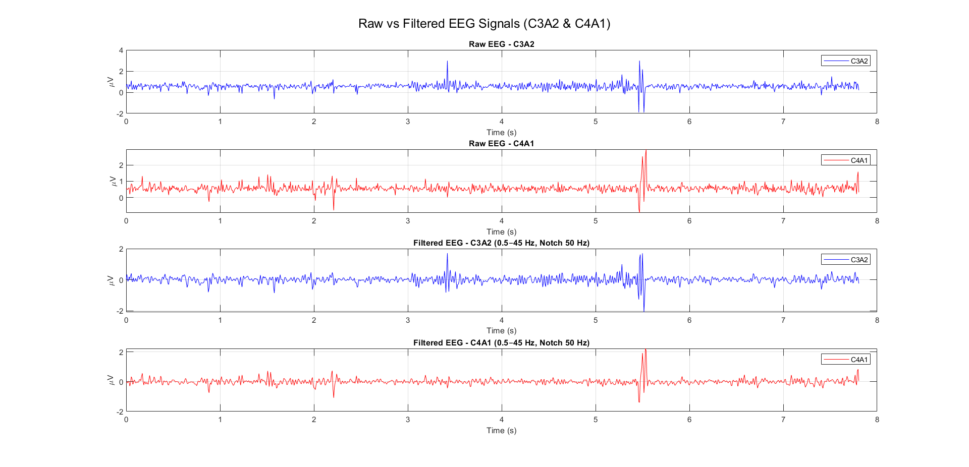
EEG EXTRACTION AND MAPPING

Slide 30
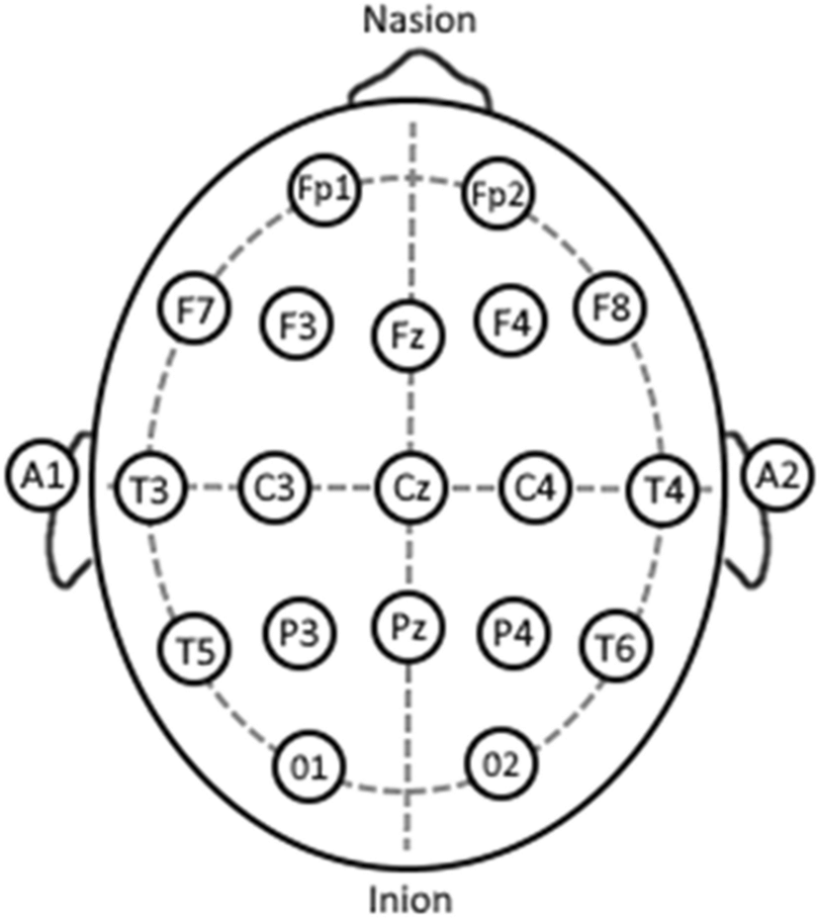
Significance of C3A2 and C4A1
Significance of C3A2 and C4A1:
Central Brain Activity Reference
Bilateral Hemispheric Representation
Correlation with Respiratory Changes
Reduced Artifact Susceptibility
Alpha Intrusion Identification
Inference:
C3-A2 (blue) and C4-A1 (red) raw EEG signals show amplitude ranges of approximately ±2–4 µV, which is normal for EEG.
Presence of high-frequency noise and possible artifacts, shown as spikes indicating muscle or movement activity.
Spikes around 6s remain even after filtering, suggesting they are physiological events (i.e, arousals ) and not electrical noise.

Slide 31
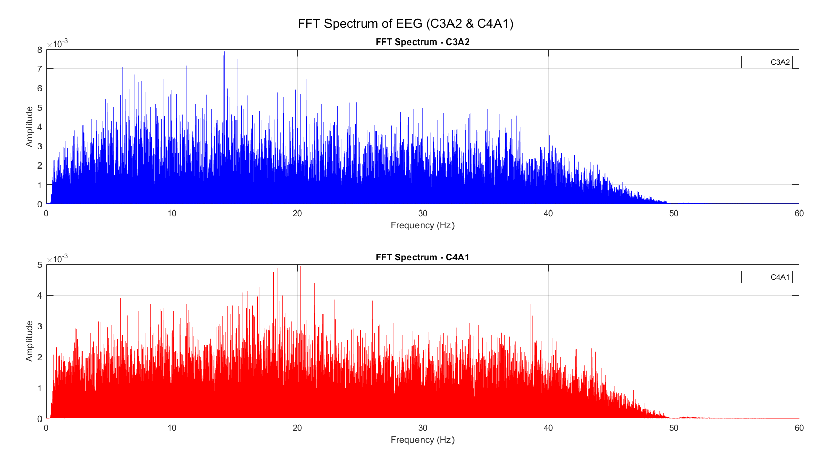
FFT of C3A2 and C4A1

Slide 32
Inference from FFT
Delta–Theta (0.5–8 Hz):
Broad low-frequency peak ,slow activity associated with sleep stages.
Alpha (8–13 Hz):
Peaks around 9–12 Hz, stronger in C3-A2, alpha intrusions or relaxed wakefulness.
Beta (13–30 Hz):
Notable peaks at 18–22 Hz, more visible in C4-A1,indicates light sleep/arousal or mild EMG contamination.
High-Frequency (>30–45 Hz):
Very low energy; sharp roll-off near 45–50 Hz, confirming band-pass and 50 Hz notch filtering.

Slide 33
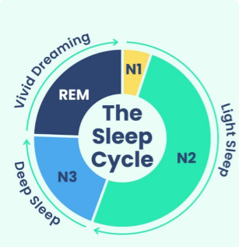
SLEEP CYCLE
On average, we undergo 4 to 6 90-minute sleep cycles per night.

Slide 34
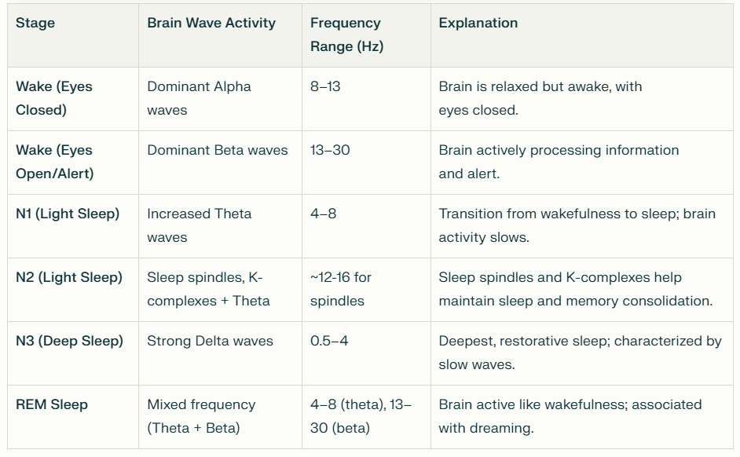
SLEEP CYCLE

Slide 35
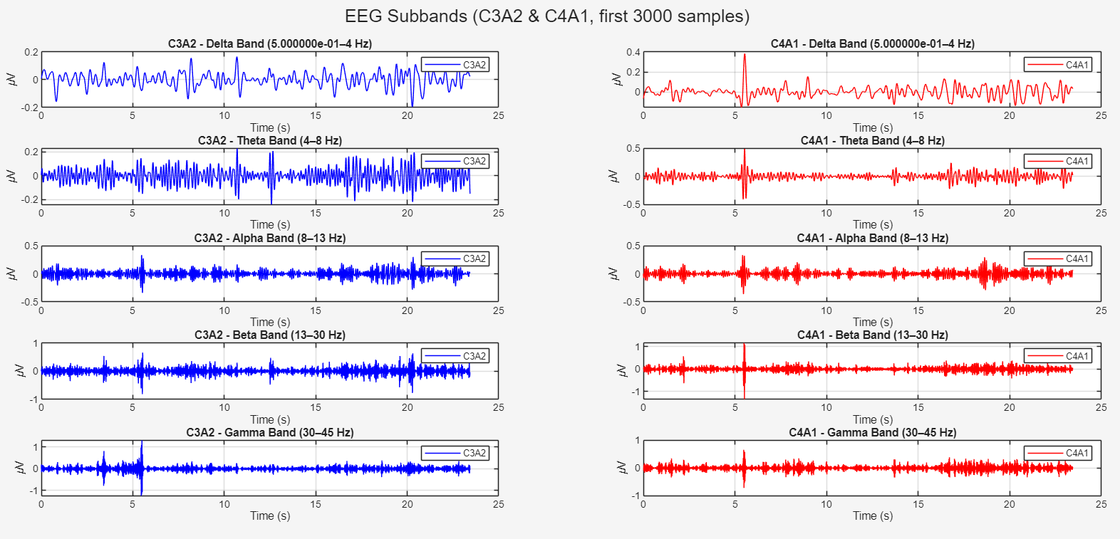
SUBBAND EXTRACTION

Slide 36
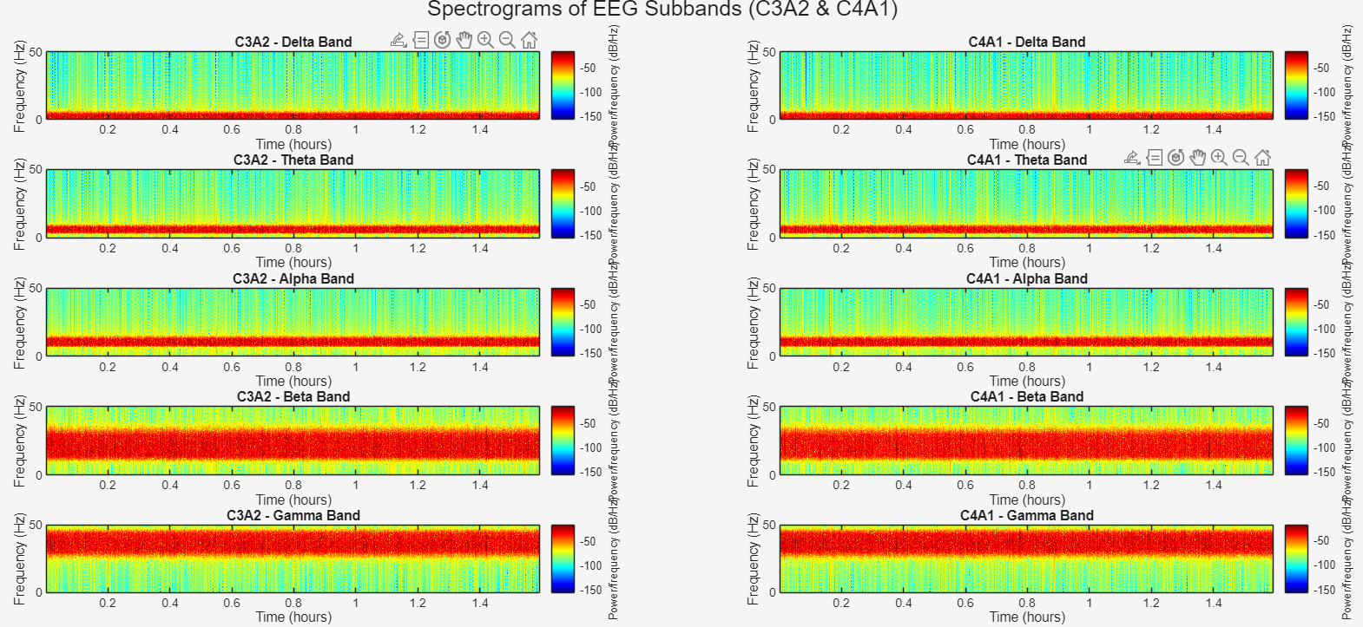
SPECTROGRAMS

Slide 37
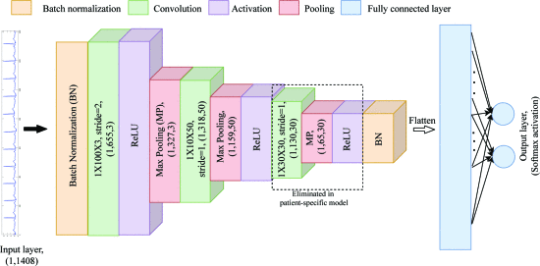
CONVOLUTIONAL NEURAL NETWORKS
Fig: The 1D-CNN model proposed for sleep apnea detection. A. John, B. Cardiff and D. John, "A 1D-CNN Based Deep Learning Technique for Sleep Apnea Detection in IoT Sensors," 2021 IEEE International Symposium on Circuits and Systems (ISCAS), Daegu, Korea, 2021, pp. 1-5, doi: 10.1109/ISCAS51556.2021.9401300.

Slide 38
CONVOLUTIONAL NEURAL NETWORKS
Conv1: 3 filters, kernel=100, stride=2 | Large receptive field (100 samples ≈ 0.78 sec). Extracts coarse temporal features (slow rhythms, large apnea-related fluctuations). Small number of filters (3) keeps parameters low.
Conv2: 50 filters, kernel=10, stride=1 | Smaller receptive field. Detects finer temporal oscillations (like sleep spindles, micro-arousals). 50 filters increase representational capacity.
Conv3: 30 filters, kernel=30, stride=1 | Intermediate receptive field. Captures medium-scale temporal dependencies (apnea onset–offset transitions). 30 filters refine learned features before classification.
Total parameters: ~50,909
Loss: Binary Cross-Entropy
Optimizer: Adam (Adaptive Moment Estimation) (lr=0.001)

Slide 39
DATASET CONVERSION
The mapped CSV EEG data is not directly compatible with hardware (FPGA/ASIC) implementations.
.mem (.coe)files are required to initialize memory blocks in HDL simulations and hardware testbenches.
Conversion ensures efficient data access and avoids delays from parsing CSV during simulation.
Provides a standard numeric format (hex/fixed-point) across all 28 patient datasets.
Makes the dataset reusable, scalable, and reproducible for different hardware designs.

Slide 40
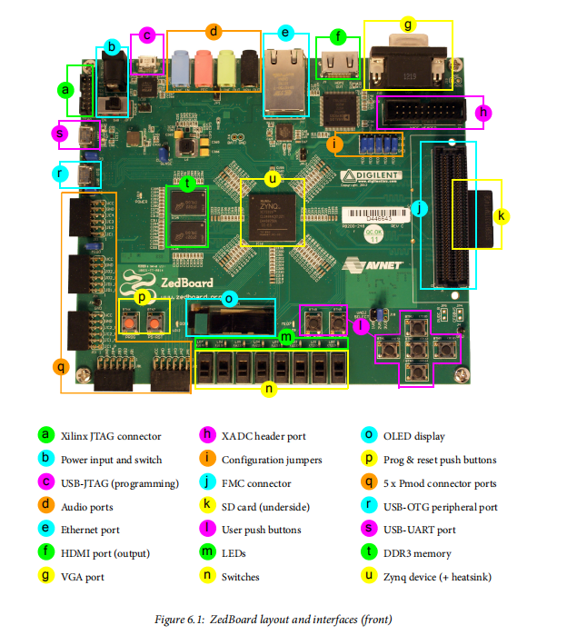
FPGA - ZYNQ 7000 ZEDBOARD

Slide 41
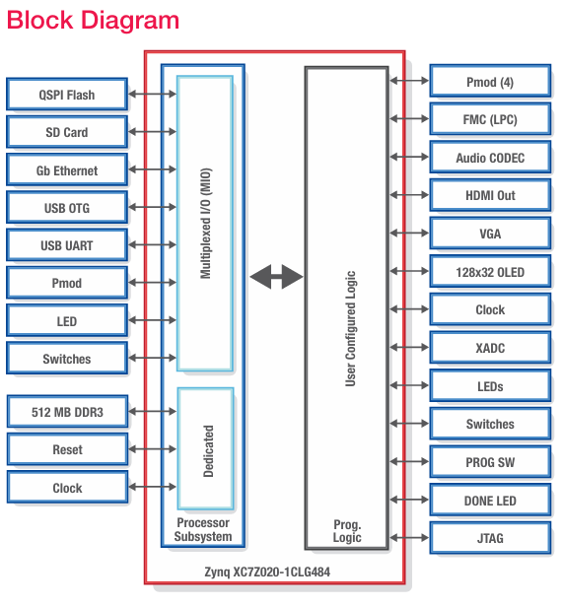
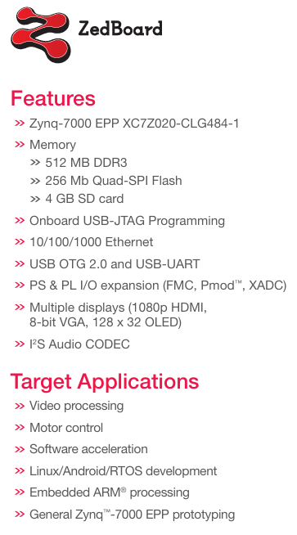
ARCHITECTURE & FEATURES

Slide 42
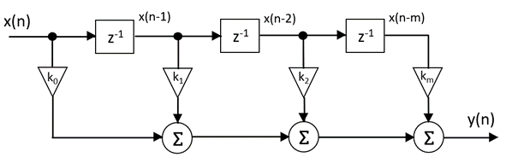
FIR Bandpass Filter
Why FIR Bandpass Filter
FIR filters are always stable because they have no feedback.
Their linear phase property preserves the EEG waveform shape (important in medical processing).
A bandpass FIR removes unwanted low-frequency drift (DC, motion artifacts) and high-frequency noise (muscle, power-line) while keeping the useful EEG sub-bands (Delta, Theta, Alpha, Beta)

Slide 43
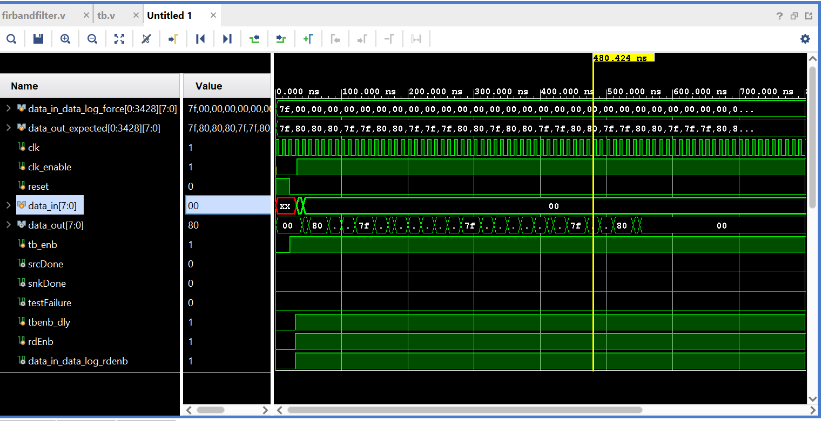
FIR FILTER DESIGN
Output Waveform:

Slide 44
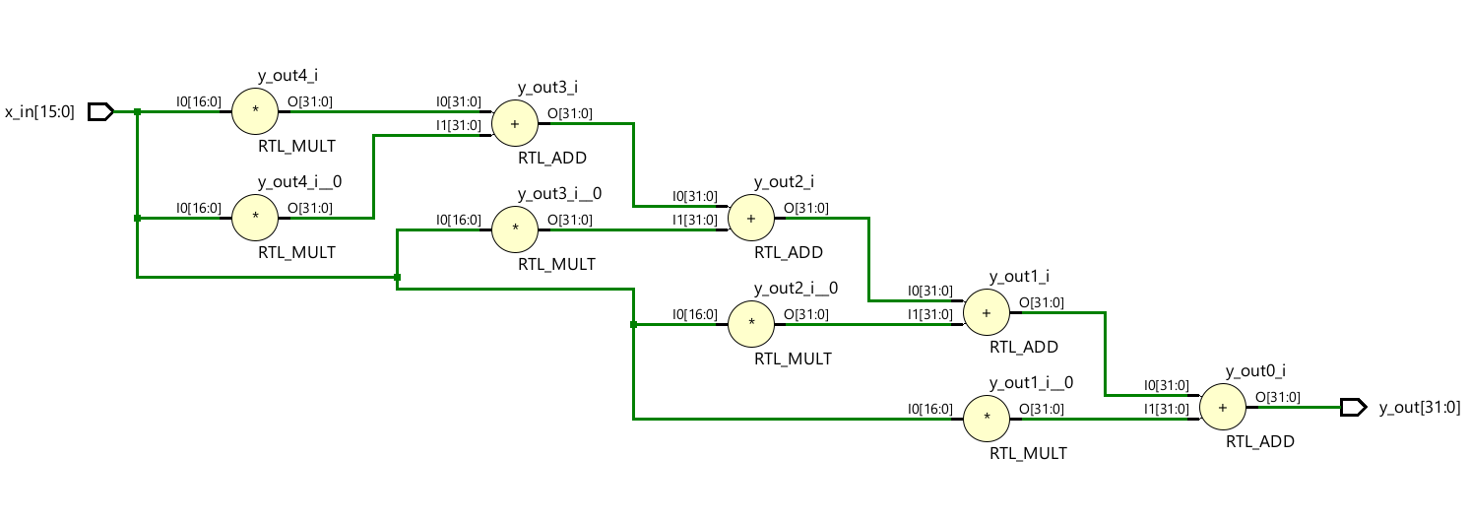
SCHEMATIC

Slide 45
Timeline
 | JULY |  |  |  | AUGUST |  |  |  | SEPTEMBER |  |  |  | OCTOBER
WEEK | 1 | 2 | 3 | 4 | 5 | 6 | 7 | 8 | 9 | 10 | 11 | 12 | 13 | 14 | 15 | 16
Literature Review
Dataset Exploration & Biosignal Understanding
Signal Preprocessing
Feature Extraction
Hybrid CNN Design
Verilog Implementation + Testing
Evaluation + Report Writing

Slide 46
Conclusion
The project began by:
acquiring sleep apnea datasets from PhysioNet St. Vincent and the Cleveland Family Study, focusing on EEG extraction from PSG(Polysomnography) recordings.
Apnea events were mapped with EEG in time sequence to align neural activity with breathing disruptions.
Preprocessing involved bandpass filtering to remove artifacts and decomposition into five frequency bands (Delta, Theta, Alpha, Beta, Gamma). Spectrograms and FFTs were generated in MATLAB.
1D CNN and classifiers were explored to evaluate performance.
For hardware transition, an FIR bandpass filter was designed in Vivado, and .csv EEG data was converted to .mem format for FPGA readability.
Future work targets model improvisation, verilog and FPGA implementation of
the trained CNN in Verilog, bridging clinical accuracy with hardware efficiency
for real-time, scalable apnea diagnostics.

Slide 47
References
[1] Hadj Salah, S. B., Chouchene, M., & Sayadi, F. E. (2024). FPGA implementation of a Convolutional Neural Network for Alzheimer's disease classification. In 2024 21st International Multi-Conference on Systems, Signals & Devices (SSD) (pp. 193-198). IEEE.
[2] Sağlam, S., Tat, F., & Bayar, S. (2019). Fpga implementation of cnn algorithm for detecting malaria diseased blood cells. In 2019 International Symposium on Advanced Electrical and Communication Technologies (ISAECT) (pp. 1-5). IEEE.
[3]Selvathi, D., & Nayagam, R. D. (2016). FPGA implementation of on-chip ANN for breast cancer diagnosis. Intelligent Decision Technologies, 10(4), 341-352.
[4] Khan, M., Moiz, A., Khan, G. N., Wajid, M., Usman, M., & Ali, J. (2025). An FPGA Prototype for Parkinson’s Disease Detection using Machine Learning on Voice Signal. IEEE Access.
[5]Alam, M. S., Siddiqui, Y., Hasan, M., Farooq, O., & Himeur, Y. (2024). Energy-efficient FPGA based sleep apnea detection using EEG signals. IEEE Access, 12, 40182-40195.
[6]Ragusa, D., Rodriguez-Almeida, A. J., Gazzoni, M., Torti, E., Marenzi, E., Fabelo, H., ... & Leporati, F. (2024). FPGA Design of Digital Circuits for Phonocardiogram Pre-Processing Enabling Real-Time and Low-Power AI Processing. In 2024 27th Euromicro Conference on Digital System Design (DSD) (pp. 588-595). IEEE.

Slide 48
References
[7] Karthick, S., & Devarasu, N. (2025). VLSI Architecture for Modulating Nerve Activity in Parkinson’s disease Using STFT Transformation Methods. In 2025 Eleventh International Conference on Bio Signals, Images, and Instrumentation (ICBSII) (pp. 1-7). IEEE.
[8] Kocaoğlu, S. (2025). FPGA implementation of deep learning architecture for ankylosing spondylitis detection from MRI. Scientific Reports, 15(1), 21854.
[9] Chen, C., da Silva, B., Yang, C., Ma, C., Li, J., & Liu, C. (2023). AutoMLP: A framework for the acceleration of multi-layer perceptron models on FPGAs for real-time atrial fibrillation disease detection. IEEE Transactions on Biomedical Circuits and Systems, 17(6), 1371-1386.
[10] Pan, S. Y., Nguyen, D. H., & Chao, P. C. P. (2025). Hardware-accelerated neural network model for early prediction of sudden cardiac arrest based on heart rate variability metrics. Microsystem Technologies, 31(5), 1231-1245.
[11] Hassan, O., Paul, T., Thakker, R., Parvin, D., Shuvo, M. M. H., Mosa, A. S. M., & Islam, S. K. (2022). A multi-sensor based automatic sleep apnea detection system for adults using neural network inference on FPGA. In 2022 IEEE International Symposium on Medical Measurements and Applications (MeMeA) (pp. 1-6). IEEE.
[12]Hassan, O., Paul, T., Amin, N., Titirsha, T., Thakker, R., Parvin, D., ... & Islam, S. K. (2023).
An optimized hardware inference of SABiNN: Shift-accumulate binarized neural network for
sleep apnea detection. IEEE Transactions on Instrumentation and Measurement, 72, 1-11.

Slide 49


